Slide 1

Graph Theory and Its Applications
Centrality Analysis
Dr. Arti Arya
Department of Computer Science
and Engineering

Slide 2

Graph Theory and Its Applications
Degree Centrality
Arti Arya
Department of Computer Science and Engineering

Slide 3

Graph Theory and its Applications Acknowledgement
The slides are prepared from various resources of Foreign and Indian Universities and from reliable resources from the internet. The contribution is also from various Professors of the University.

Slide 4
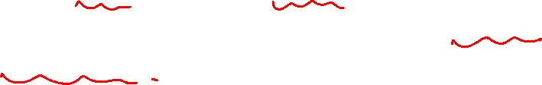
Graph Theory and Its Applications UE21CS343AB3
Centrality Analysis
Used to measure the importance (or “centrality”) as in how “central” a node is in the graph of various nodes in a graph.
Each node could be important from an angle depending on how “importance” is defined.
So, centrality comes in different flavors and each flavor or a metric defines importance of a node from a different perspective

Slide 5
Graph Theory and its Applications UE21CS343AB3
Centrality Analysis
Degree Centrality
Betweenness Centrality
Closeness Centrality
Eigenvector centrality
Katz Centrality
Pagerank Centrality
Group Centrality
Bonacich Centrality

Slide 6
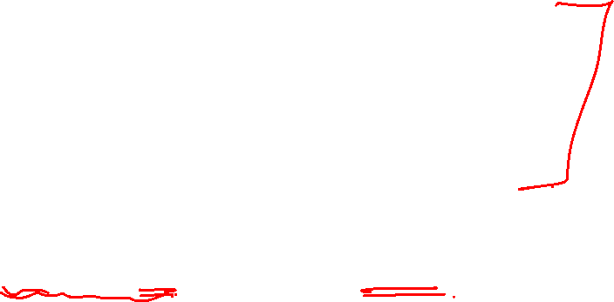
Graph Theory and its Applications UE21CS343AB3
Centrality Analysis
Pls allow me to quickly brush: DEGREE of a node and Degree Distribution.
Degree:
the no. of egdes connected to a node in an undirected graph.
The no. of edges pointing towards the node in a directed graph: in-degree ( eg no. of followers of a person)
The no. of edges pointing away from the node: out-degree
( no. of followees a person follow)
Degree Distribution: Prob dist. Of the degrees over the whole network.

Slide 7
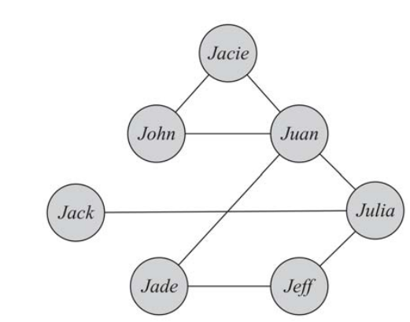

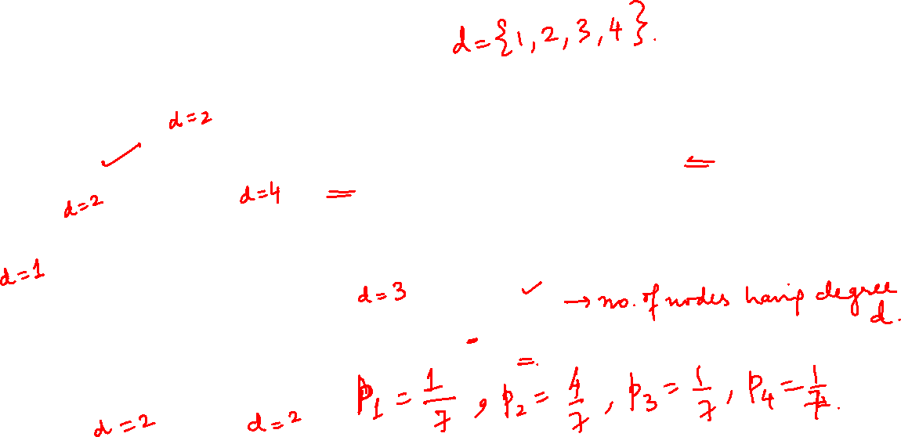
Graph Theory and its Applications UE21CS343AB3
Centrality Analysis
Degree Distribution: Prob dist. Of the degrees over the whole network.
In very large graphs, distribution of node degrees (degree distribution) is an important attribute to consider.
In a graph with n nodes, p_{d} is defined as

Slide 8

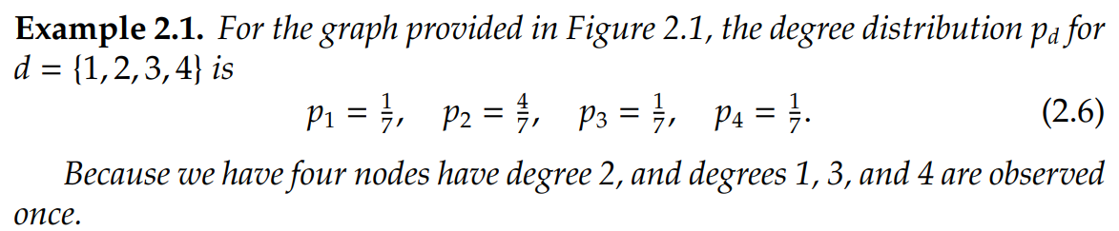
NETWORK ANALYSIS AND MINING
Centrality Analysis
.

Slide 15
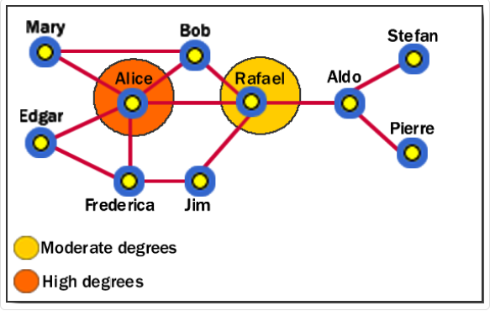

Graph Theory and its Applications UE21CS343AB3
Centrality Analysis: Degree Centrality
Degree centrality is a measure of the importance of a node (or a vertex) in a network wrt its degree.
It is the number of connections (or edges) that a node has to other nodes in the network.
Who are the central figures?
What interaction patterns are common in the friends?
Like minded users?
Alice is having the highest degree centrality (d(Alice)=5).
Can also be used to identify key individuals or groups that may play a central role in the spread of information or influence within the network.

Slide 17

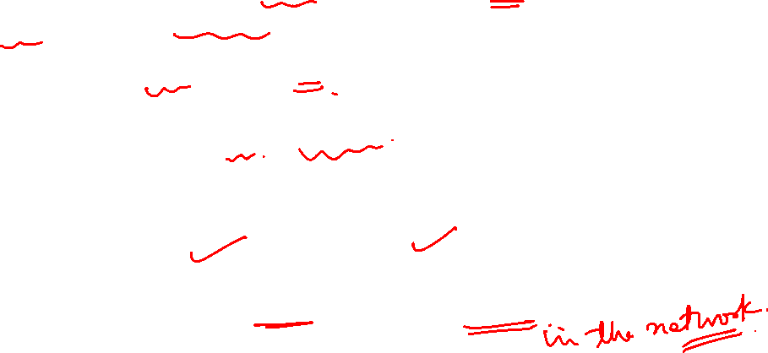
Graph Theory and its Applications UE21CS343AB3
Centrality Analysis: Degree Centrality
Definition:
Degree centrality assigns an importance score based simply on the number of links held by each node.
The degree centrality C_{d} for node v_{i} in an undirected graph is
where d_{i} is the degree (number of adjacent edges) of node v_{i} .
When to use it:
To find very connected individuals, popular individuals, individuals who are likely to hold most information etc.

Slide 18
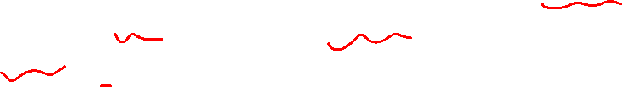
Graph Theory and its Applications UE21CS343AB3
Degree Centrality in Digraph
In directed graphs, we can either use the in-degree, the out-degree, or the combination as the degree centrality value:
d^{out}_{i} is the number of outgoing links for vertex v_{i}

Slide 19
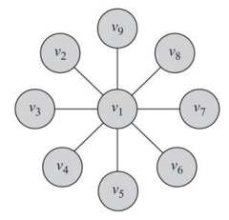
Graph Theory and its Applications UE21CS343AB3
A very simple Example
Degree centrality for node v1=8
and for all other nodes =1

Slide 20

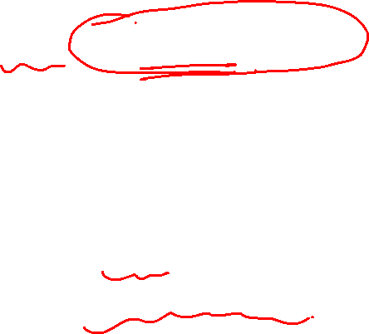
Graph Theory and its Applications UE21CS343AB3
A Problem!!!
There is a problem:
If I wish to compare centrality across the networks!!!!
Then, will the degree centrality as it work or Not??
NOPE!!!!
To compare degree centralities across networks ( Say Facebook and Insta), one must normalize these values……..

Slide 21
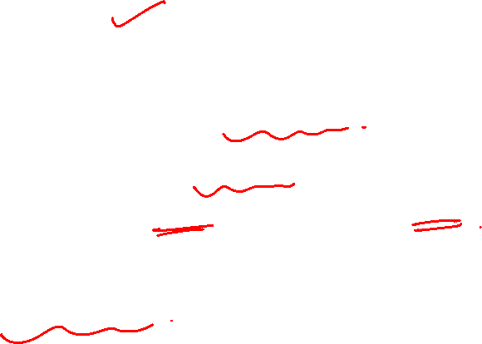
NETWORK ANALYSIS AND MINING
A Problem!!!
A node of degree 9: is this node important?
Depends on the size of the n/w
Suppose a network has 11 nodes ( node is important) and the same node in a n/w of 101 nodes( not imp).
So need to normalize…..

Slide 23
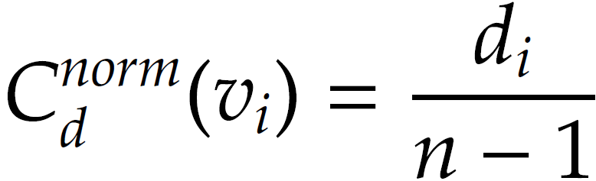
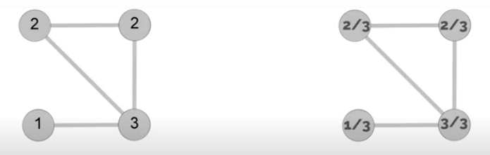
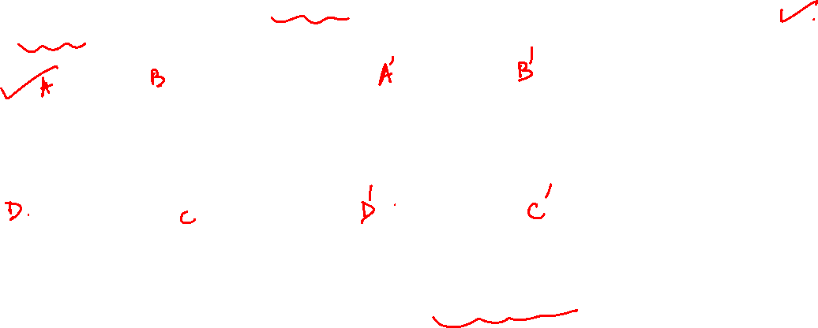
Graph Theory and its Applications UE21CS343AB3
Normalized Degree Centrality
Normalized by the maximum possible degree
Degree Centrality Normalized degree Centrality

Slide 24
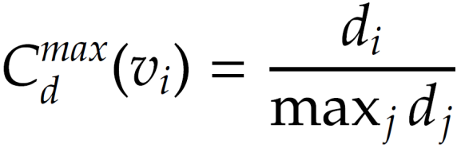
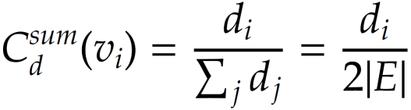
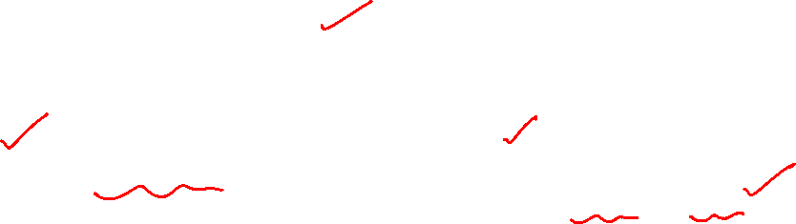
Graph Theory and its Applications UE21CS343AB3
Normalized Degree Centrality
Normalized by the maximum degree
Normalized by the degree sum
The first one is meso-level analysis by Freeman i.e. express this as a fraction of centrality in star network (which is the maximum)
The summation of degrees in an undirected graph is twice the number of edges

Slide 25
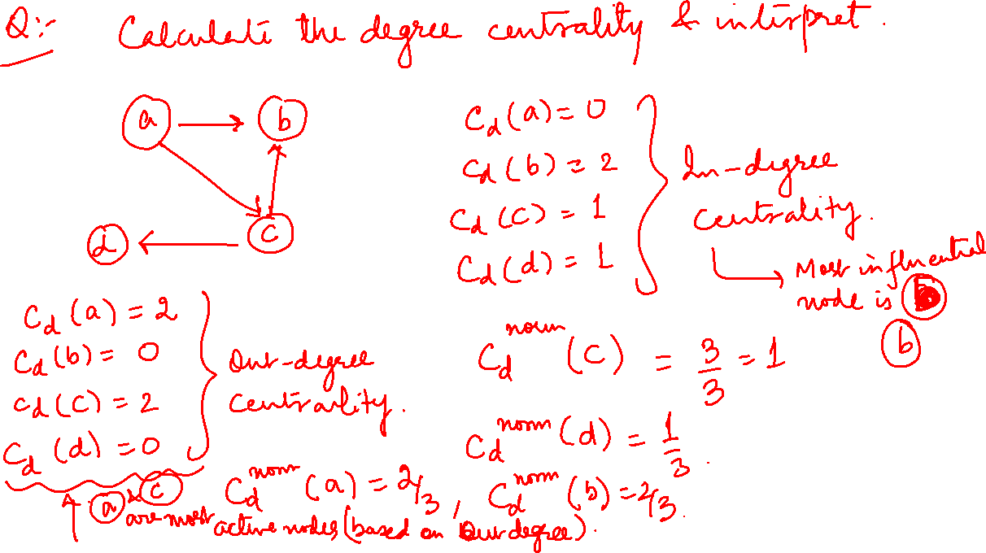

Slide 26
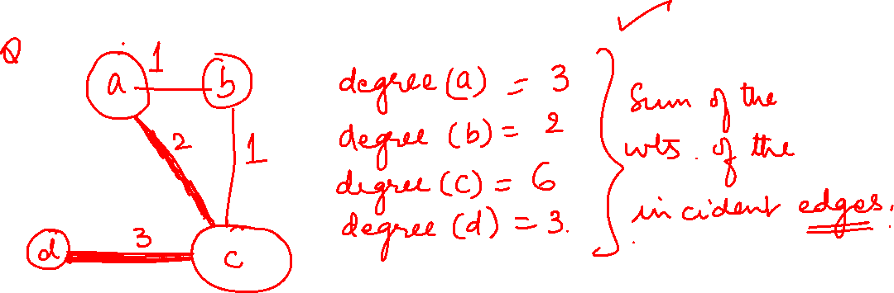
Graph Theory and its Applications UE21CS343AB3

Slide 27
Graph Theory and its Applications UE21CS343AB3
Interpretation of normalized degree centrality
Linton Freeman (one of the authors of UCINET) developed basic measures of the centrality of actors
based on their degree
the overall centralization of graphs.
As indicated earlier, this can be calculated based on out degree, in- degree or ignoring direction.
If interested in comparing across networks, this can be standardized as a % of nodes (no of nodes in the network -1 ) i.e. ego is excluded
Graph centralisation measures : since star network is the most centralized network, express the degree of inequality or variance in our network as a percentage of that of a perfect star network of the same size.
This is like a normalized degree centrality where normalization done wrt maximum possible degree.

Slide 39
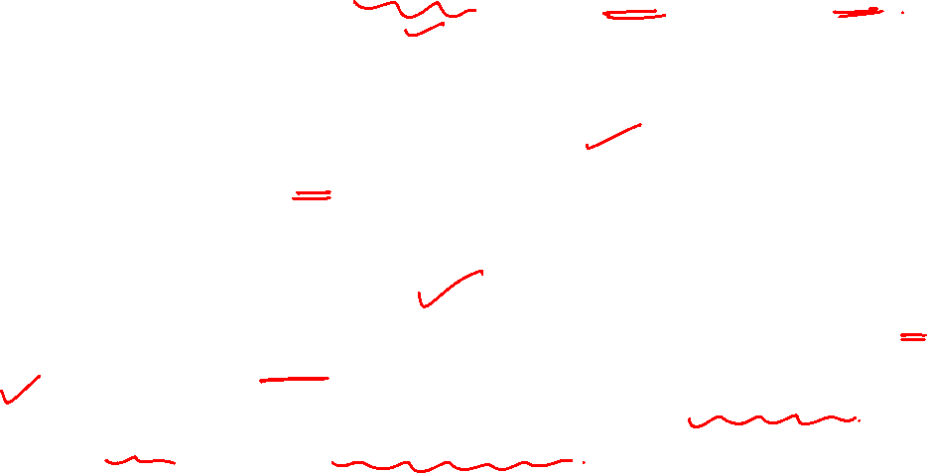
Graph Theory and its Applications UE21CS343AB3
Some points about degree centrality for undirected and directed graphs
Does not look at direction of edges: Analysed on undirected graph but not on digraph.
Calculated on matrices holding binary symmetric data. So before calculating degree centrality, ensure that edge data are both binary and symmetrical.
Does not work well with edge weights : Degree centrality can be calculated on valued data (weighted edge) but the resulting degree centrality score will bias towards stronger ties and will not be necessarily reflective of centrality

Slide 56
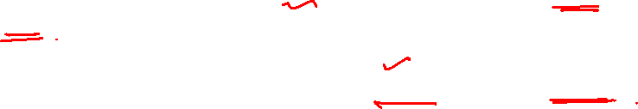
Graph Theory and its Applications UE21CS343AB3
About degree centrality
A clear disadvantage of degree centrality is that
it can only be used to make comparison between actors on the same network
If you want to compare between actors of two different networks , they have to be of the same size as measures are based on size of the network.
Hence, Freeman converted centrality scores into proportions i.e. normalized centrality

Slide 57
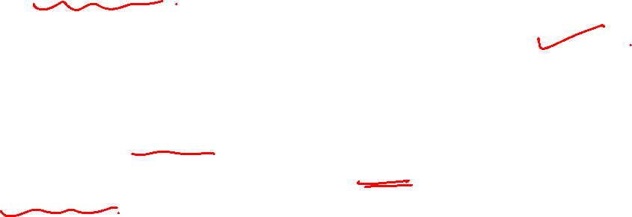
Graph Theory and its Applications UE21CS343AB3
About degree centrality
Should you compare networks that differ greatly in size ?
NO
An actor in a small network, by virtue of small number of actors in the network, will have a greater chance of connecting to other actors ( high density).
Hence higher normalized degree centrality !
Smaller networks then tend to have higher density scores !!

Slide 58
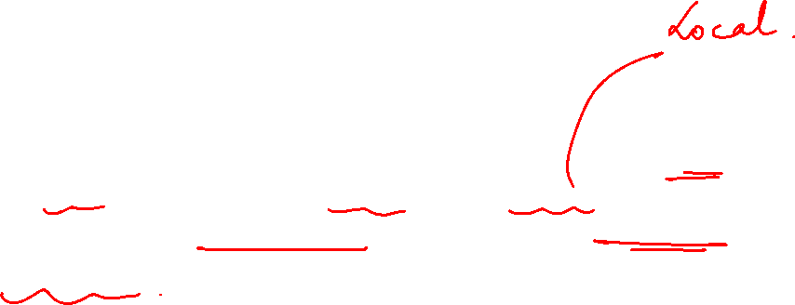
Graph Theory and its Applications UE21CS343AB3
About degree centrality
A node with a high degree centrality may be capable of affecting a lot of neighbors in its neighborhood at once, but we cannot say anything about the opportunities for global outreach.

Slide 59
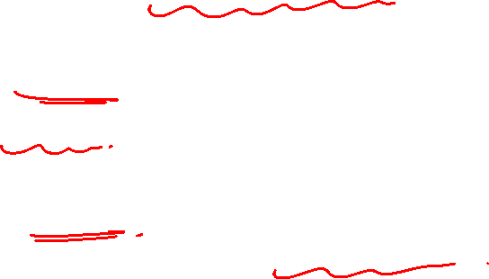
Graph Theory and its Applications UE21CS343AB3
About degree centrality
If you perceive the direction of ties are important, you may prefer indegree and outdegree centrality.
These are calculated on digraph.
Indegree centrality : no of ties received by an actor. measure of prestige or popularity.
Outdegree centrality : no of ties given by an actor. measure of expansiveness or gregariousness

Slide 60
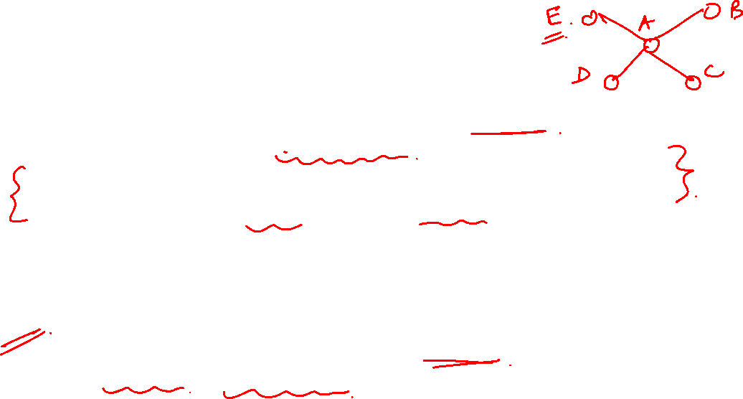
Graph Theory and its Applications UE21CS343AB3
Intuition: Betweenness Centrality
Degree centrality does NOT consider the rest of the network ( only look at immediate ties or ego network )
Sometimes it is not important how many people you know but rather where you are placed in the network
In communication networks, betweenness centrality measures how much potential control an actor has over the flow of information.
More specifically, it measures how many times an actor sits on the “geodesic” ( shortest path) between two other actors together.

Slide 68


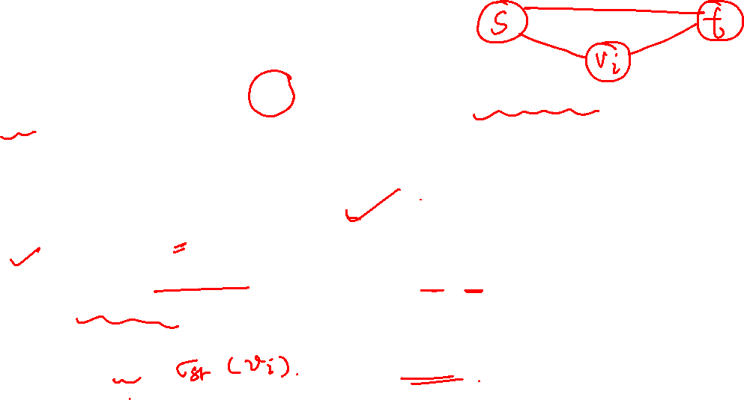
Graph Theory and its Applications UE21CS343AB3
Betweenness centrality
In other words, how central v_{i}’s role is in connecting any pair of nodes s and t. This measure is betweenness centrality.
For node v_{i} , we compute the # of shortest paths between other nodes thru v_{i ,} which is given by
the number of shortest paths from vertex s to t ( also known as
information pathways)
the number of shortest paths from s to t that pass through v_{i.} Terms where =0, are not considered, since this means that s and t belong to different components.

Slide 71
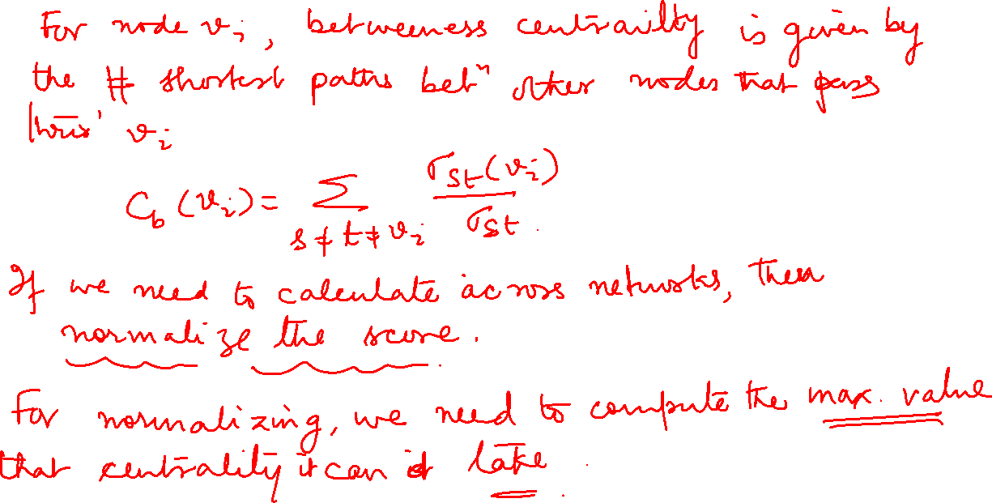

Slide 73
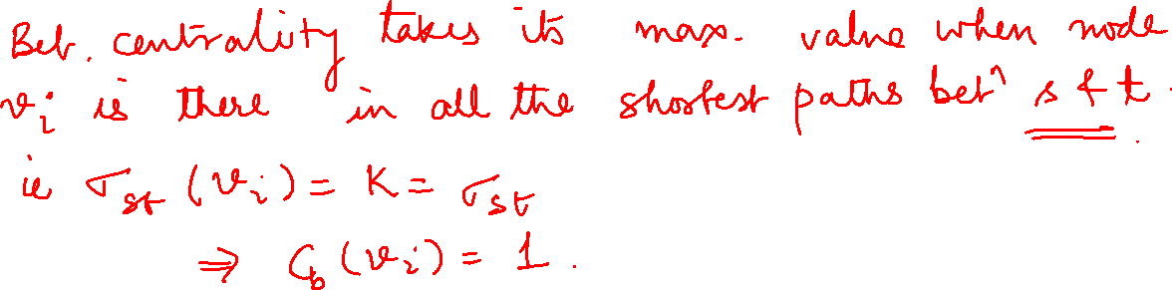
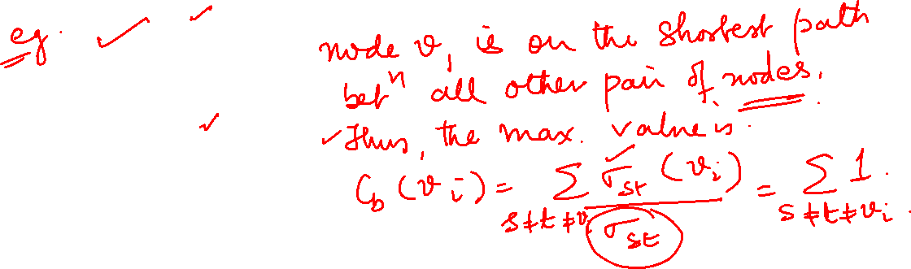

Slide 75
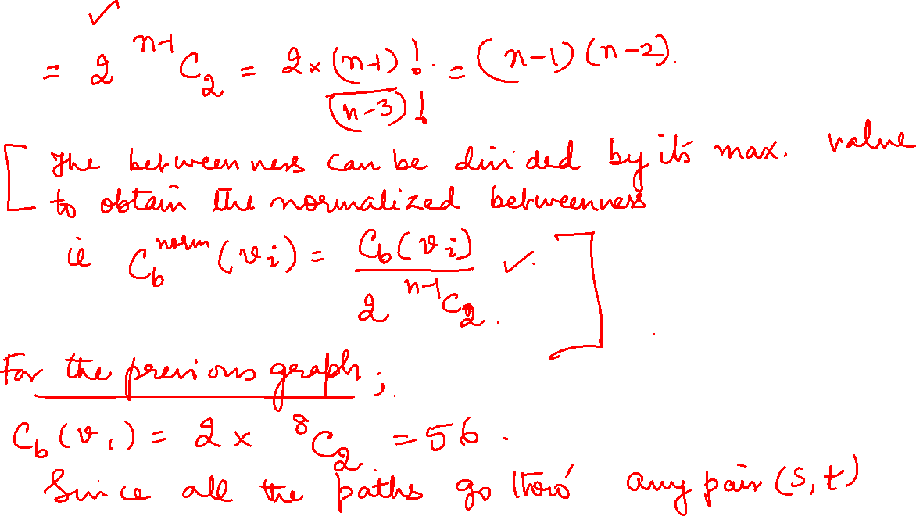

Slide 76
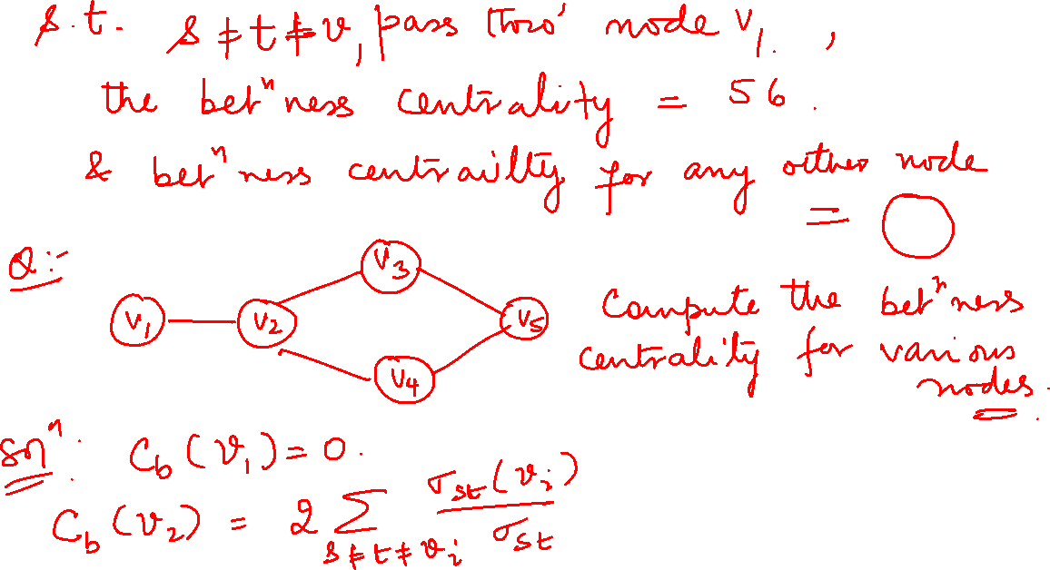
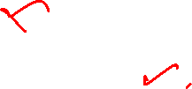

Slide 77
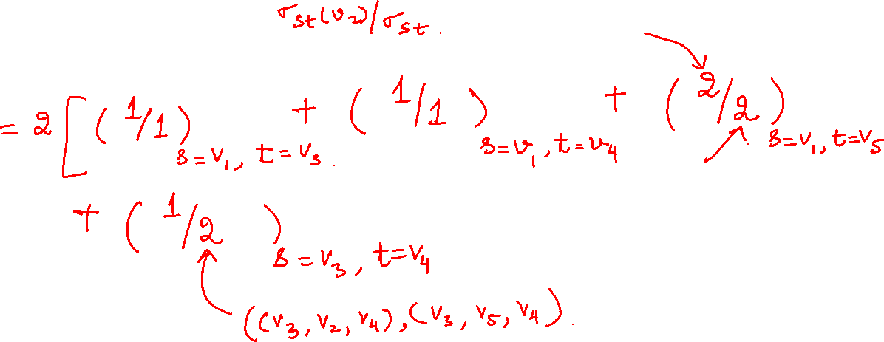
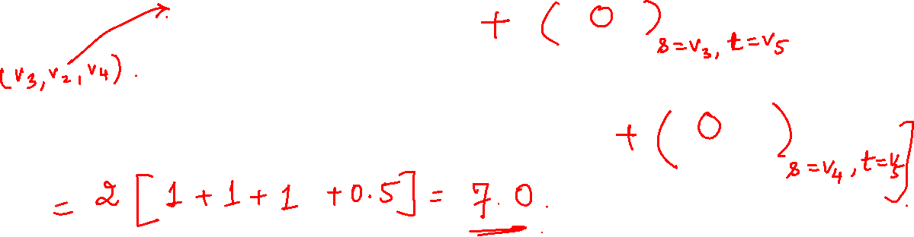
More examples

Slide 78
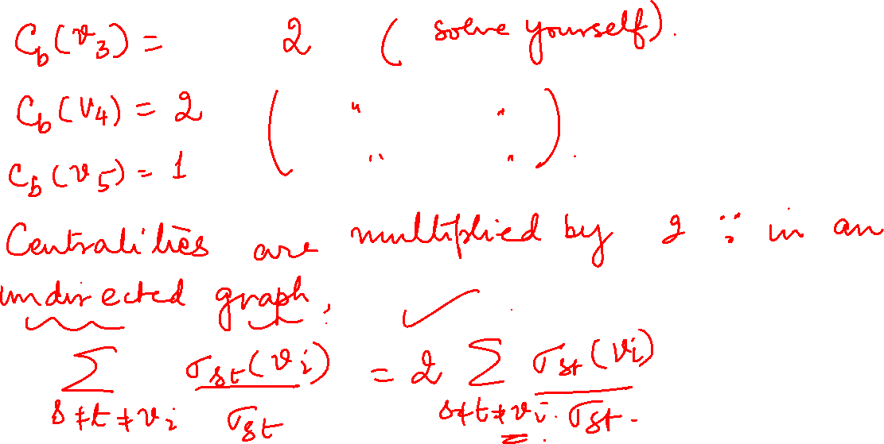

Slide 79
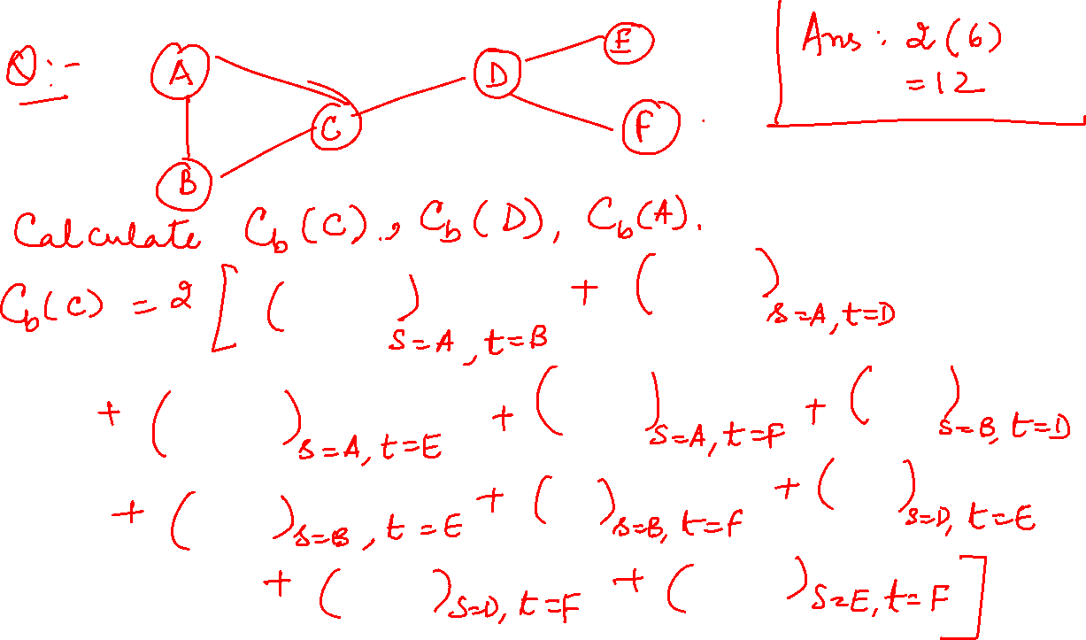

Slide 80
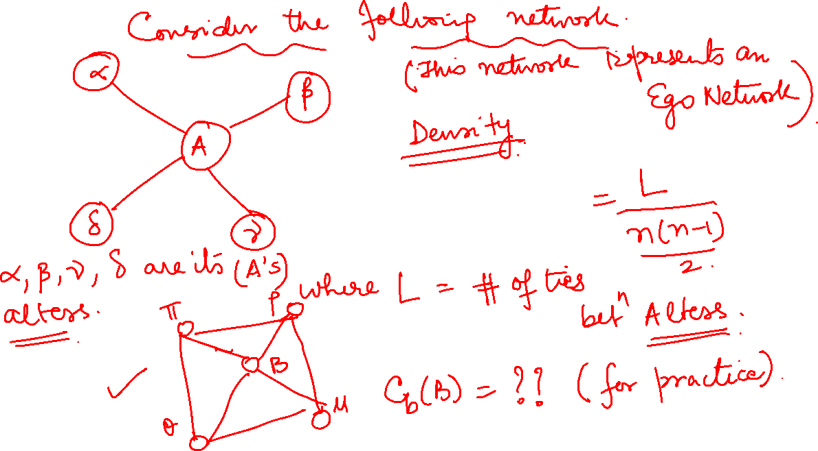

Slide 81
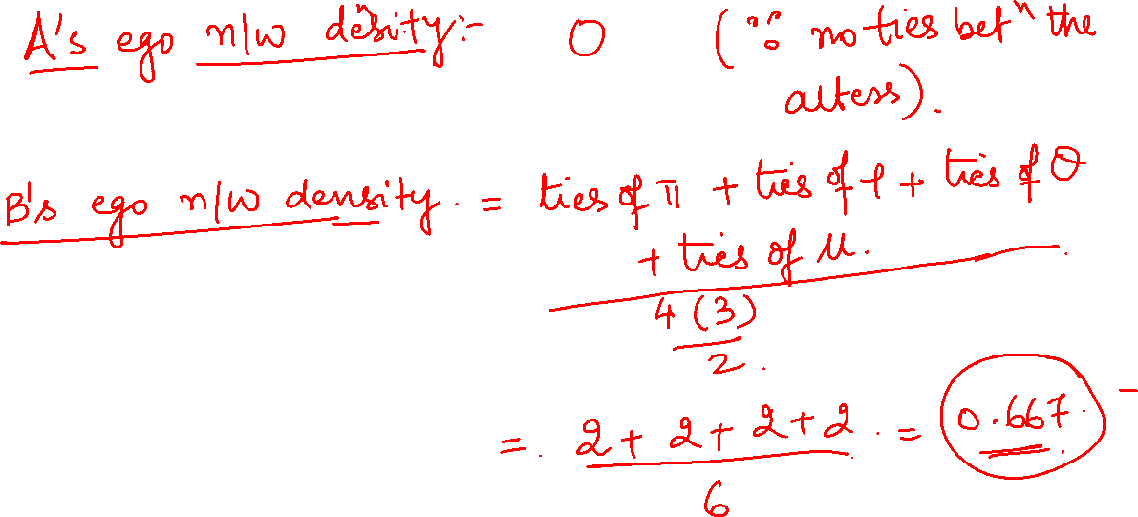

Slide 82
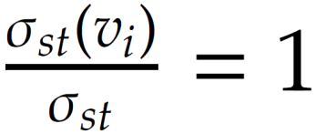
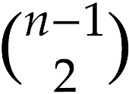
Graph Theory and its Applications UE21CS343AB3
Normalized Betweenness Centrality
In the best case, node v_{i} is on all shortest paths from s to t, hence,
Hence max value
A natural choice is to divide it with the total number of (ordered) vertex pairs or maximum possible value for the betweenness
But you may need not consider the factor 2 towards direction
Therefore, the maximum value is 2 considering directed edge
Betweenness centrality:
Normalized

Slide 84
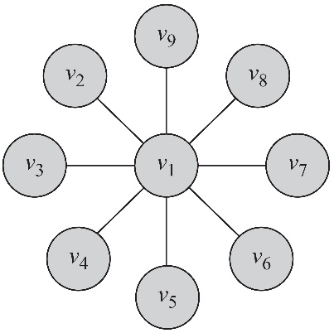
Graph Theory and its Applications UE21CS343AB3
Calculate
From the figure calculate for v₁
Since all the paths that go through any pair (s; t); s , t , v₁ pass through node v₁, the centrality is 2 (⁸C₂) considering direction
Normalized betweenness centrality is 1
Similarly, the betweenness centrality for any other node in this graph is 0

Slide 85
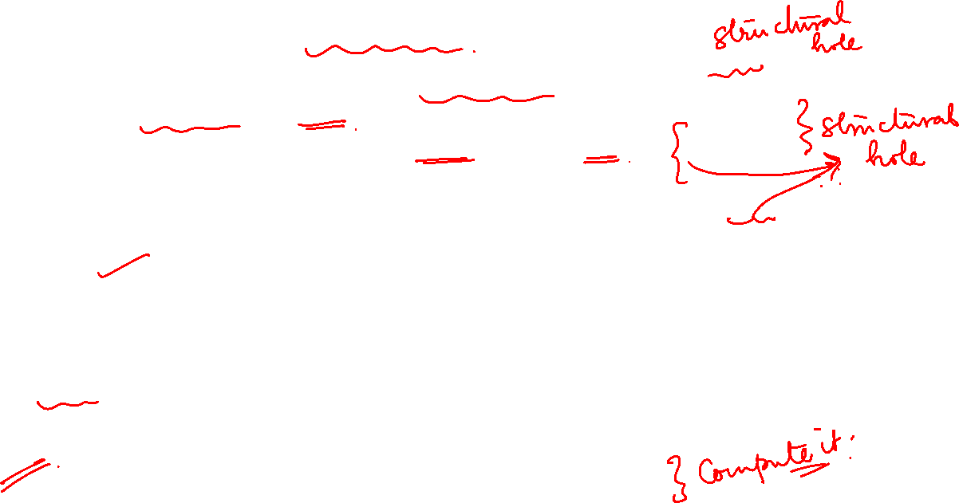
Graph Theory and its Applications UE21CS343AB3
Betweenness centrality and structural hole
A structural hole refers to an “empty space” between contacts in a person's network.
It means that these contacts do not interact closely (though they may be aware of one another).
Actors on either side of the structural hole have access to different flows of information.
Ronald Burt coined term “structural holes”
In the figures, A’s alters are disconnected but B’s alters are completely connected
A gets diverse inputs whereas B is receiving redundant information mostly . This structural holes will benefit A more than B
B has a lower betweenness centrality score compared to A. (Compute!!!)
A
B
85

Slide 86
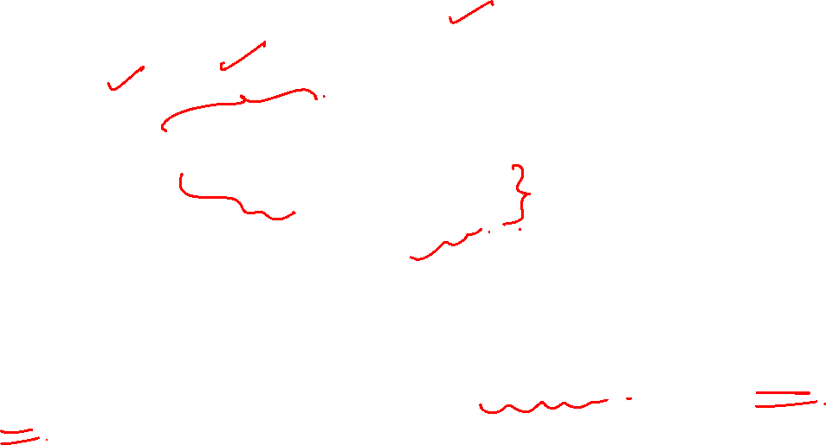
NETWORK ANALYSIS AND MINING
Structural holes
Group 1
Group 2
Group 3
People usually focus on activities inside their own network group, which creates “holes” in the information flow between groups, called, structural holes (Burt & Ronchi, 2005).

Slide 87
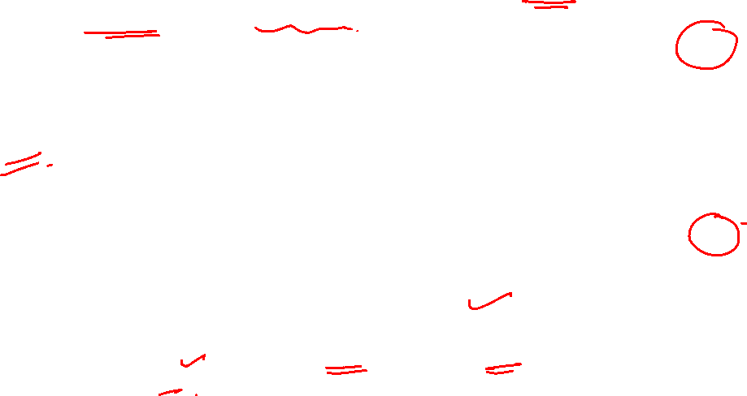
Graph Theory and its Applications UE21CS343AB3
Betweenness centrality and structural hole
So, high betweenness centrality is characterized by more structural holes in ego network !!
A’s ego network density score is 0.00 and B has 0.6667
So, for ego network, less density score means more structural holes !!
Ego network: An ego network is a type of social network that focuses on one individual (called the ego) and the people (called the alters) who are directly connected to them.
An ego network also includes the ties or relationships among the alters, such as friendship, collaboration, or communication.
A
B
87

Slide 88
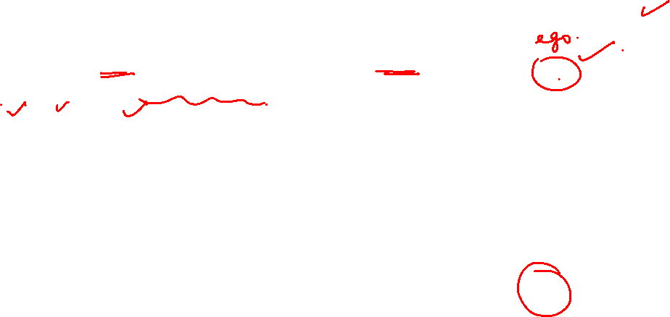
Graph Theory and its Applications UE21CS343AB3
Structural Hole and Brokerage Opportunity for Ego
C
B is the ego taking advantage of structural hole between A and C
A, B and C same group
Coordinator broker : B brokering between two members of same group ( manager of a team and all in same group)
A and C same group, B different
Consultant broker : A,C same group and B different ( ex- B is stock broker and A,C are buyer and seller)
B
C
A
B
C
A

Slide 89
Graph Theory and its Applications UE21CS343AB3
Structural Hole and Brokerage Opportunity for Ego
C
A and C different group
Representative broker : B represents and negotiates on behalf of A to C
Gatekeeper broker : transaction begins at A, passes to another group C’s gatekeeper B . ( B census bureau, C govt dept, A public)
A,B,C different group
Liaison broker : A,B,C are different groups and B plays a neutral role ( actor, Casting Director and Producer in Bollywood)
B
B
C
C
A
A
B
C
A

Slide 90
THANK YOU
Dr. Arti Arya
Department of Computer Science and Engineering
artiarya@pes.edu

